Slide 1
Automating the Cybersecurity Triage Process
EEMCS / TCS
A Comparative Study on the Performance of Large Language Models
PASCAL BAKKER
SUPERVISED BY JAIR SANTANNA
2024-07-05

Slide 2



Hospital – TRIAGE
Immediate
Emergent
Urgent
Less urgent
Non-urgent
2

Slide 3


Hospital – TRIAGE
Immediate
Emergent
Urgent
Less urgent
Non-urgent
2

Slide 4


The problem with triage
Immense numbers of alarms
Too little time → Superficial analysis
Fatigue → Missed alarms
Burnout / turnover
Human error
3

Slide 5


Large language models (LLMs)
Natural Language Processing
Much data → General understanding
Generating natural language
Identifying contextual relationships
Recognizing complex patterns
Analyzing semantics
Many existing applications
→ Automate triage
4

Slide 6
Research questions
How can LLMs be integrated into the existing incident response workflow to streamline the triage process?
What suitable evaluation metrics should be used to assess the performance of LLMs in cybersecurity triage?
How do different LLMs compare in performance when optimizing the cybersecurity triage process?
5

Slide 7





Defining triage
Very little documentation
Interview
6

Slide 8

Defining triage
Understanding the alarm
Analyzing the context
Correlating the alarm
Identifying position in kill chain
Prioritizing the alarm
7

Slide 9
Optimizing triage
Using LLMS
EXISTING OPTIMIZATIONS
Organize alarms in trees [12]
Integrate thread intelligence [41]
Follow steps of senior analysts [25, 48]
8

Slide 10
Optimizing triage
Using LLMS
EXISTING OPTIMIZATIONS
Organize alarms in trees [12]
Integrate thread intelligence [41]
Follow steps of senior analysts [25, 48]
Do not automate natural language tasks
8

Slide 11
Optimizing triage
Using LLMS
Detecting cybersecurity announcement emails
Detecting relation between email and alarm
Finding correlation between alarms
Determine position in kill chain
Determine priority of alarm
9

Slide 12
Optimizing triage
Using LLMS
Detecting cybersecurity announcement emails
Detecting relation between email and alarm
Finding correlation between alarms
Determine position in kill chain
Determine priority of alarm
9

Slide 13
TASK 1
Evaluating llms
ANNOUNCEMENT DETECTION
Give email to LLM
Is this a cybersecurity announcement?
True / false
10

Slide 14
TASK 1
Evaluating llms
ANNOUNCEMENT DETECTION
Give email to LLM
Is this a cybersecurity announcement?
True / false
Customer X will add the user “sea_line” to the local administrators on the computer “FRLIM-IPC-0017”.
“True” → ✅
“False” → ❌
10

Slide 15
TASK 2
Evaluating llms
TACTIC DETECTION
Give email to LLM
What MITRE ATT&CK tactic can consequential alarms have?
e.g. “exfiltration”
11

Slide 16
TASK 2
Evaluating llms
TACTIC DETECTION
Give email to LLM
What MITRE ATT&CK tactic can consequential alarms have?
e.g. “exfiltration”
Customer X will add the user “sea_line” to the local administrators on the computer “FRLIM-IPC-0017”.
“privilege escalation” → ✅
“persistence” → ✅
“reconnaissance” → ❌
11

Slide 17
EVALUATING AND COMPARING LLMS
EVALUATION METRICS
For different prompts:
F1-score / accuracy
Median time
Error rate
12

Slide 18
EVALUATING AND COMPARING LLMS
EVALUATION METRICS
For different prompts:
F1-score / accuracy
Median time
Error rate
DATASET
40 labeled emails
20 announcements with labeled tactics
12

Slide 19
EVALUATING AND COMPARING LLMS
EVALUATION METRICS
For different prompts:
F1-score / accuracy
Median time
Error rate
DATASET
40 labeled emails
20 announcements with labeled tactics
LARGE LANGUAGE MODELS
(And variations)
GPT-4
Llama 3
Mistral
Phi-3
Gemma
Aya 23
Code Llama
12

Slide 20
RESULTS – Announcement detection
13

Slide 21
RESULTS – Announcement detection
13

Slide 22
RESULTS – Announcement detection
13

Slide 23
RESULTS – Announcement detection
13

Slide 24
RESULTS – Announcement detection
13

Slide 25
RESULTS – TACTIC DETECTION
14

Slide 26
RESULTS – TACTIC DETECTION
14

Slide 27
RESULTS – TACTIC DETECTION
14

Slide 28
RESULTS – TACTIC DETECTION
14

Slide 29
RESULTS – Comparison
15

Slide 30
RESULTS – Comparison
15

Slide 31
Research questions
How can LLMs be integrated into the existing incident response workflow to streamline the triage process?
What suitable evaluation metrics should be used to assess the performance of LLMs in cybersecurity triage?
How do different LLMs compare in performance when optimizing the cybersecurity triage process?
16

Slide 32

Research questions
How can LLMs be integrated into the existing incident response workflow to streamline the triage process?
What suitable evaluation metrics should be used to assess the performance of LLMs in cybersecurity triage?
How do different LLMs compare in performance when optimizing the cybersecurity triage process?
16

Slide 33
Research questions
How can LLMs be integrated into the existing incident response workflow to streamline the triage process?
What suitable evaluation metrics should be used to assess the performance of LLMs in cybersecurity triage?
How do different LLMs compare in performance when optimizing the cybersecurity triage process?
16

Slide 34
Research questions
How can LLMs be integrated into the existing incident response workflow to streamline the triage process?
What suitable evaluation metrics should be used to assess the performance of LLMs in cybersecurity triage?
How do different LLMs compare in performance when optimizing the cybersecurity triage process?
16

Slide 35
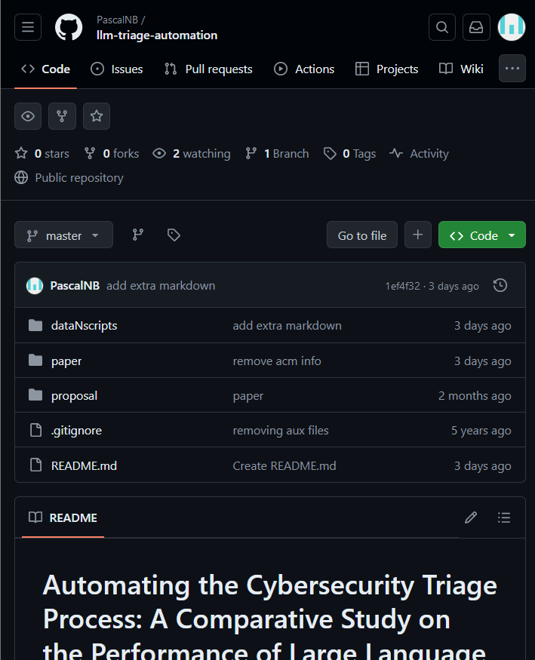
Takeaways
GPT-4 performed the best
Followed by Llama 3 and Mistral
Phi-3 3.8B good in simple tasks
Prompt size had no effect on time
Baseline towards further usage of LLMs
Defined key steps of triage
Identified optimizations
Evaluation framework
Other tasks and models
17

Slide 36
Automating the Cybersecurity Triage Process
EEMCS / TCS
A Comparative Study on the Performance of Large Language Models
PASCAL BAKKER
SUPERVISED BY JAIR SANTANNA
2024-07-05

Slide 37





The incident response workflow
Logs
SIEM
Alarms
Response
SOC

Slide 38
ERROR Rate
{
“is_announcement”: True
}
✅
{
“is_annoonment”: True
}
❌

Slide 39
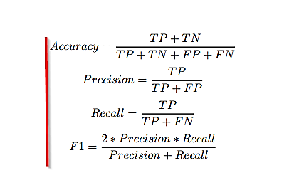
Evaluation metrics

